Slide 1
OPERATION ANALYTICS AND INVESTIGATING METRIC SPIKE
By Laxmidhar Sahoo

Slide 2
Project Description
This project involves in-depth analysis of two datasets: job data and user engagement with email metrics. The goal is to extract meaningful insights and metrics to evaluate dataset performance and growth. The job data will be examined for daily job reviews in November 2020, 7-day rolling job throughput, language distribution, and data duplicates. Meanwhile, the user engagement and email dataset analysis will focus on weekly engagement, growth, retention, per-device engagement, and email metrics. SQL will be the cornerstone for conducting these analyses, leveraging commands like SELECT, WHERE, and aggregate functions. The project aims to uncover actionable information and patterns that shed light on the datasets' effectiveness and trends.

Slide 3
Approach
My strategy for approaching this project involves employing SQL for comprehensive data analysis. I will commence by setting up the database and thoroughly reviewing the available data. The analysis will be conducted through the adept utilization of SQL commands such as SELECT, WHERE, GROUP BY, and employing aggregate functions like COUNT, SUM, and AVG, among others.
For the initial case study, I plan to compute essential metrics including throughput, language distribution, and the identification of duplicate entries. In the second case study, I will delve into calculating metrics like weekly user engagement, growth, retention, engagement per device, and email engagement. The outcomes of these analyses will be presented systematically in tabular structures. This project necessitates a profound mastery of SQL to ensure the accurate execution and attainment of the intended outcomes.

Slide 4
Tech-Stack Used
MySQL Workbench version 8.0 CE

Slide 5
Insights :
Case Study 1: Job Data Analysis

Slide 6
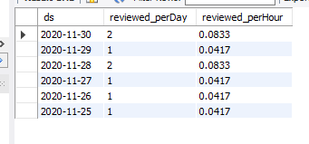
A. Number of jobs reviewed :-
Code :
SELECT ds,
COUNT(job_id) AS reviewed_perDay,
COUNT(job_id) / 24 AS reviewed_perHour
FROM job_data
WHERE ds >= "2020-11-01"
AND ds <= "2020-11-30"
GROUP BY ds;
Output :
On the date 28 and 30 November the double the jobs reviewed as per other days in the month.

Slide 7
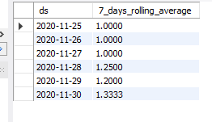
B. 7 day rolling average of throughput :-
Code :
SELECT ds,
AVG(COUNT(job_id)) OVER (ORDER BY ds ROWS BETWEEN 6 PRECEDING AND CURRENT ROW) AS 7_days_rolling_average
FROM job_data
GROUP BY ds
ORDER BY ds;
Output :
For the observation of the overall trend and smooth out fluctuations, a 7-day rolling average would be a better choice. A 7-day rolling average can provide a better representation of the long-term trend, as it reduces the impact of short-term fluctuations.

Slide 8
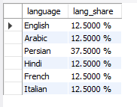
C. Percentage share of each language :-
Code :
SELECT language,
CONCAT(
(COUNT(language) / (SELECT COUNT(*) FROM job_data)) * 100,'%'
) AS lang_share
FROM job_data
GROUP BY language;
Output :
Persian language has the highest share 37.5 % and other language has the similar share throughout.

Slide 9
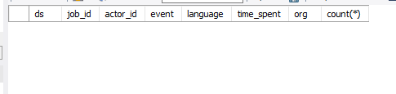
D. Duplicate rows :-
Code :
SELECT ds,
job_id,actor_id,
event,
language,
time_spent,
org,
COUNT(*) AS duplicate_count
FROM job_data
GROUP BY ds,
job_id,
actor_id,
event,
language,
time_spent,
org
HAVING COUNT(*) > 1;
Output :
There are no duplicated rows in the data.

Slide 10
Insights :
Case Study 2: Investigating Metric Spike

Slide 11
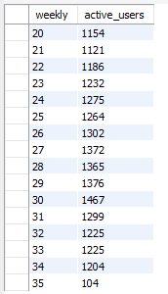
A. User Engagement (Weekly) :-
Output :
Code :
SELECT WEEK(occurred_at) AS weekly,
COUNT(DISTINCT user_id) AS active_users
FROM events
WHERE event_type = "engagement"
GROUP BY weekly, event_type;
The highest engagement of users in the week 30 that is 1467 and all the other weeks are in the range 1100 to 1400.

Slide 12
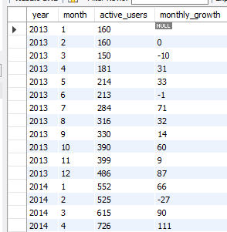
B. User Growth For The Product :-
Code :
WITH monthly_act_users AS (
SELECT
YEAR(activated_at) AS year,
MONTH(activated_at) AS month,
COUNT(user_id) AS active_users
FROM users
WHERE state = "active"
GROUP BY year, month
)
SELECT *,
(active_users - LAG(active_users) OVER (ORDER BY year, month)) AS monthly_growth
FROM monthly_act_users;
Output :
The growth is increasing month by month after 4th month of 2013 and lowest in the 2nd month of 2014.

Slide 13
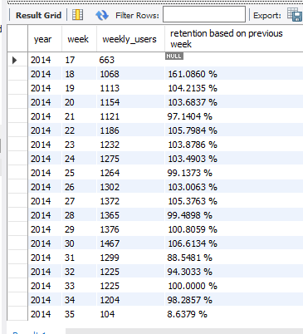
C. Weekly Retention:-
Code :
SELECT *,
CONCAT(
(
(weekly_users / LAG(weekly_users) OVER (ORDER BY year, week)) * 100
),
'%'
) AS "retention based on previous week"
FROM (
SELECT
YEAR(occurred_at) AS year,
WEEK(occurred_at) AS week,
COUNT(DISTINCT user_id) AS weekly_users
FROM events
WHERE event_name = "login"
GROUP BY year, week
) a;
Output :

Slide 14
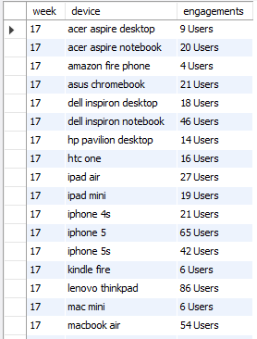
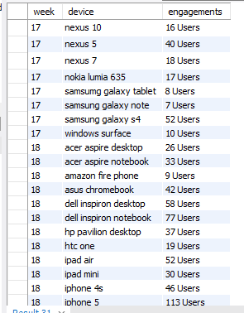
D. Weekly Engagement per device:-
Output :
Code :
SELECT
WEEK(occurred_at) AS week,
device,
CONCAT(
COUNT(DISTINCT user_id),
' users'
) AS engagements
FROM events
WHERE event_type = 'engagement'
GROUP BY week, device;
Weekly Engagement is highest in the all Apple company devices and further decrease in other devices.

Slide 15

E. Email Engagement :-
Code :
SELECT
CONCAT(
ROUND(
(COUNT(CASE WHEN action = 'email_open' THEN 1 END) /
COUNT(CASE WHEN action IN ('sent_weekly_digest', 'sent_reengagement_email') THEN 1 END)) * 100
),' %'
) AS "email opened rate",
CONCAT(
ROUND(
(COUNT(CASE WHEN action = 'email_clickthrough' THEN 1 END) /
COUNT(CASE WHEN action IN ('sent_weekly_digest', 'sent_reengagement_email') THEN 1 END)) * 100
),
' %'
) AS "email clickthrough rate"
FROM email_events;
Output :

Slide 16
Result
1. Grasping the project's objectives and data under examination.
2. Enhancing database creation and handling of extensive data.
3. Elevating SQL proficiency, encompassing intricate queries and aggregates.
4. Strengthening analytical thinking and problem-solving acumen.
5. Deepening comprehension of job review and user engagement measurements.

Slide 17
Thank you

